Slide 1
Fungal circumvention of host immune response

Slide 2
Host-Fungal Immune Interactions
Broadly, CLEC7A, CARD9, IL-17, and IL-22 have been implicated in immune clearance of fungi
Beyond this, we know “little if and how intestinal commensal fungi interact with the host immune system”
(Underhill, 2014)

Slide 3
GI Colonization of Fungi
Microbial GI translocation promoted by:
Microbiome dysregulation
Increased permeability of intestinal mucosal barrier
Host immunodeficiencies
(Shoham, 2005; Berg, 1999)

Slide 4
Commensality to Pathogenicity
Candida albicans is typically a commensal fungus present in the mouth and GI tract of about 80% of humans
Disease may occur only when immune system is attenuated

Slide 5
Commensality to Pathogenicity
Likely uses transcriptional programs to invade tissue and further evade immune response
In vivo transcriptional profiling may be needed to describe the progression of infection and complex time-dependent patterns of gene expression
(Hube, 2004)

Slide 6
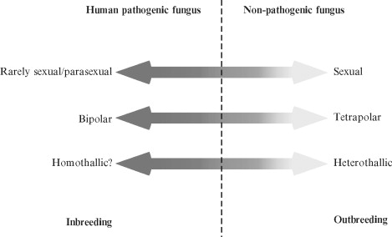
Adaptive Sex and Virulence
“[H]uman pathogenic fungi have retained the ability to generate either clonal or recombining population structures in response to either constant or changing environments by preserving their ability to undergo sexual reproduction but limiting the conditions under which sexual reproduction occurs.”
(Nielsen, 2007)

Slide 7
Adaptive Sex and Virulence
E.g., C. neoformans can undergo a meiotic process that promotes recombinational repair in the host’s oxidative environment
Fusion and meiosis can also occur between non-isogenic α strains, enabling genetic exchange
(Michod, 2008; Lin, 2005)

Slide 8
References
Berg, R. (1999). Bacterial translocation from the gastrointestinal tract. Advanced Experimental Medical Biology, 473, 11 – 30.
Hube, B. (2004). From commensal to pathogen: Stage- and tissue-specific gene expression of Candida albicans. Current Opinion in Microbiology, 7, 336 – 341.
Lin, X., Hull, C., & Heitman, J. (2005). Sexual reproduction between partners of the same mating type in Cryptococcus neoformans. Nature, 434, 1017 – 1021.
Michod, R., Bernstein, H., & Nedelcu, A. (2008). Adaptive value of sex in microbial pathogens. Infection, Genetics, and Evolution, 8, 267 – 285.
Nielsen, K., & Heitman, J. (2007). Sex and virulence of human pathogenic fungi. Advances in Genetics, 57, 143 – 173.
Shoham S, Levitz SM. (2005). The immune response to fungal infections. British Journal of Haematology, 129, 569 – 582.
Underhill, D., & Iliev, I. (2014). The mycobiota: interactions between commensal fungi and the host immune system. Nature Reviews Immunology, 14, 405 – 416.

